Slide 1
Fingerprint Minutiae
By Matthew ambriz and Pedro Rivas

Slide 2

A quick recap of AFIS
AFIS – Automation of Fingerprint Search
Created in the early 60’s
The goal of the database
How accurate it is
How it is used
Notes:
Picture from http://planetfreewill.com/wp-content/uploads/2016/04/twitpic-19.jpg

Slide 3
Pros and cons
Reduced cost and man hours
Helps identify a person
Improve the fingerprint
Solve cold cases
Wrong place wrong time
Needs a better fingerprint
Examiners could be biased
Keep in mind! “it is easier to exclude a suspect than to convict someone based on a DNA match.” (Educational Resources Development Council, n.d.)
Notes:
Can DNA Demand A Verdict? Retrieved from Learn Genetics: http://learn.genetics.utah.edu/content/science/forensics/

Slide 4
The three points
Step one
Step two
Step three
Pre-Processing
75-175 POI
Extracted from ink
Saved onto database
Minutiae Extraction
Recorded into the database
In high quality
Minimizes errors
Lower res == nosier photo
Post Processing
Skeletonizes the image
Eliminate false minutiae
Smudges
Over inking
Under inking

Slide 5
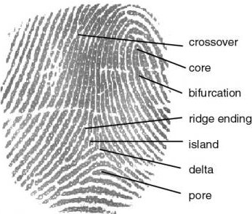
Fingerprint minutiae
Crossover
Core
Bifurcation
Ridge Ending
Island
Delta
Pore

Slide 6
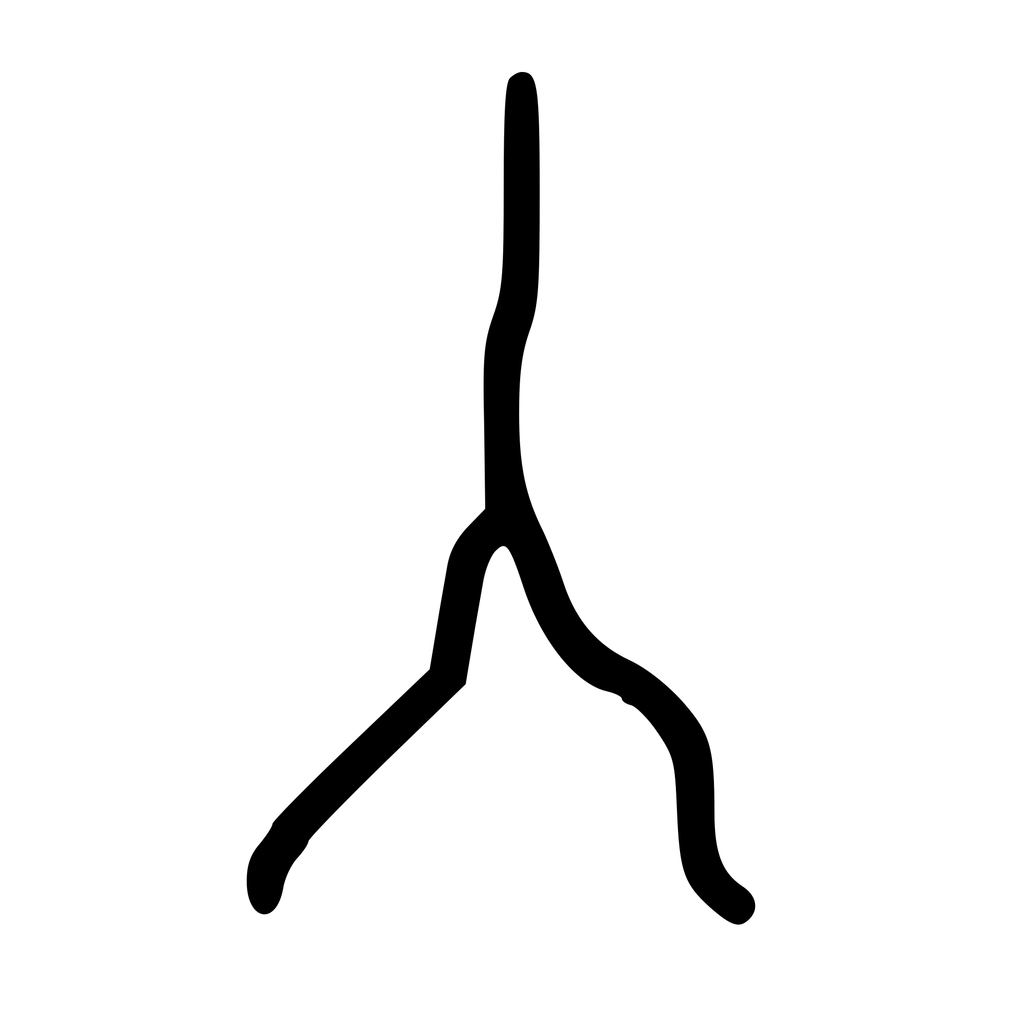

Minutiae Detection
You only need an algorithm to detect either an ending ridge or bifurcation point since they are inverse of one another.
The point we are looking for in an ending ridge is where the ridge stops.
The point the system looks for in a bifurcation is where single ridge splits off into two or two ridges join into a single one.

Slide 7
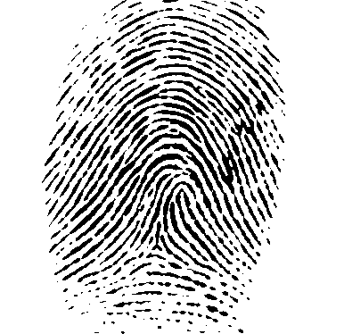
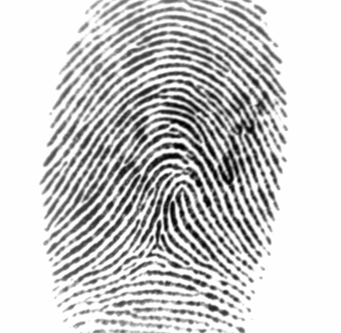
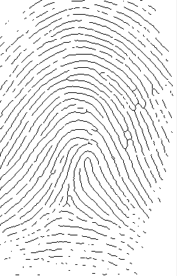
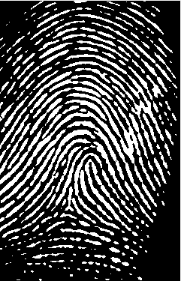
Image Enhancement
Blur the image in order to reduce the image ‘noise’ and fill any holes that can cause missing data for any image that doesn’t meet the minimum AFIS requirements.
Create a black and white (binary) version of the image and invert it.
Skeletonize the image by eroding the edges until a single pixel width is achieved.

Slide 8
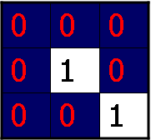
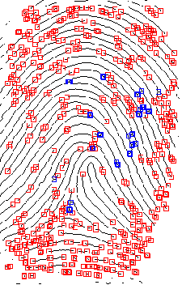
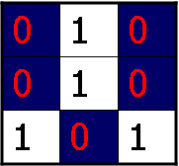
Minutiae Detection and Post processing
Boolean matrix is ran through an algorithm that scans each pixel and checks its eight nearest neighbors.
A for loop scans the image row by row and it’s neighbors are checked by using the current pixel’s x and y coordinates.
To find an ending ridge only one of its nearest neighbors can have a positive value.
To find a bifurcation point exactly three of its neighbors must have a positive value.

Slide 9

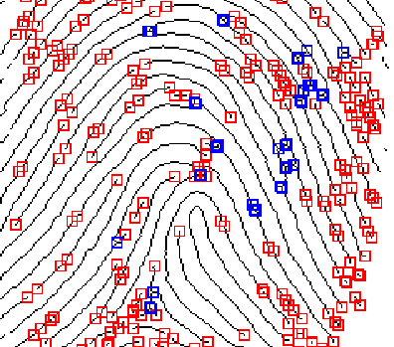
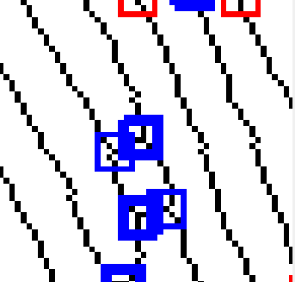
FINAL RESULT

